Slide 1
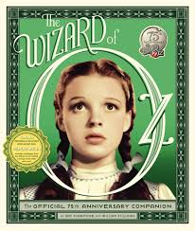
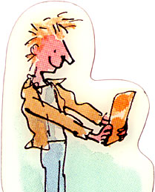
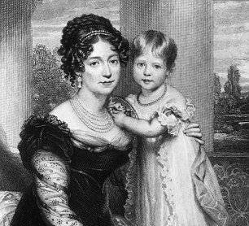
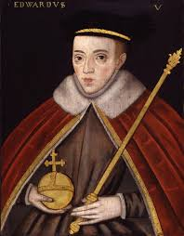
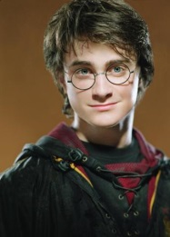
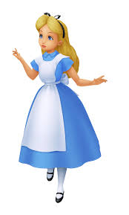
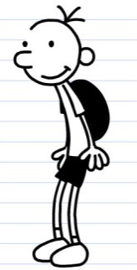
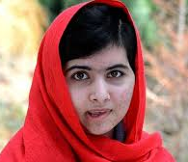
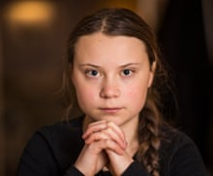
Year 5 Home Learning: Autumn term 1
Children’s Rights: Right or Wrong?
Pupil/Parent challenge:
This half term, we will be exploring the differences and similarities between the lives of children in the past and today.
Choose a well known child: this can be a fictional child, a historical figure or a famous child today, and consider how this child has, or does not have, rights. You may also want to think about whether this child is a role model to children today.
As an extra challenge, can you think about a brand new (appropriate!)right that this child should be given to support them?
Due in: Wednesday 9th October
Which rights did these children have?
Pupil challenge: Present information about your child in any interesting way. Some possible ideas are: diary entries, a PowerPoint, a poster, as report etc. Think about the UNCRC and the rights this child had/has.
??? THE FUTURE ???
What could Article 43 be?
Parent Challenge: Please help your child to choose a child and think about the life they led/lead. Encourage them to think about the rights this child had/has and the possible differences and similarities between this child and your own child’s life.
What rights do children have
today?

