Slide 1

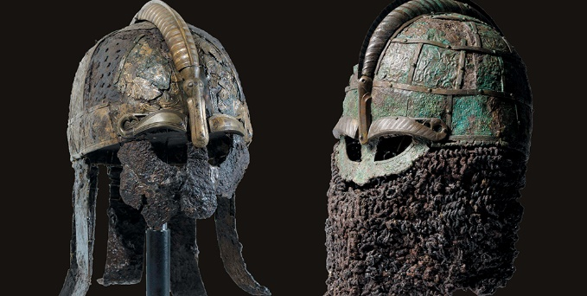

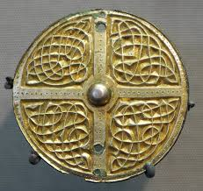
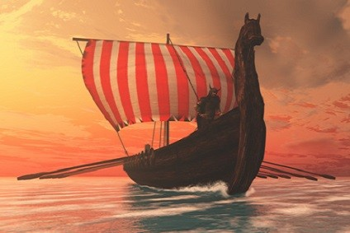
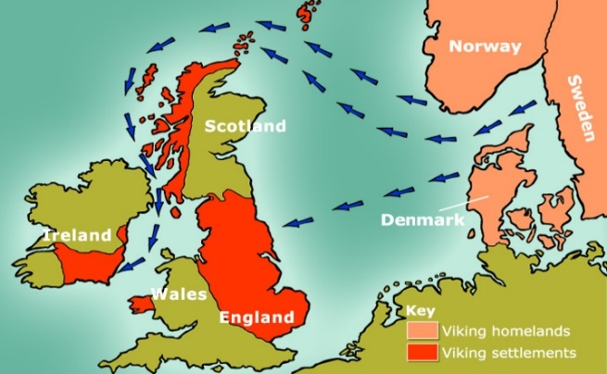

Year 5 Home Learning
Spring term 1
Why did the Vikings invade?
Pupil/Parent challenge:
This half term we are historians. We will be using a variety of sources to learn about the Vikings and their invasion of Britain!
Using the internet, a book, pictures or videos, find out what the Vikings did in everyday life. What jobs did they have? Where did they live? What type of home did they have? What did the children do? What did they eat?
Present your findings in an interesting way.
Possible ideas:
Cook a Viking meal
Build a model of a Viking village
Design and label Viking clothing
PowerPoint, poster
Poem
Due: Tuesday 28th January 2025
Who were the Vikings?
What did the Vikings do when they were not raiding and invading?

